Slide 1
Error Detection & Correction Techniques

Slide 2
Polynomial codes for error detection/correction
Bitstring represents polynomial.
Eg. 110001 represents:
= 1 . x⁵ + 1 . x⁴ + 0 . x³ + 0 . x² + 0 . x¹ + 1 . x⁰ = x⁵ + x⁴ + x⁰

Slide 3
Degree of a Polynomial
degree of the polynomial is 6
The bit pattern in this case has 7 bits.

Slide 4
We define addition and subtraction as modulo 2 with no carries or borrows. This means addition = subtraction = XOR.
011 + (or minus)
110
------
101
------
Consider the polynomials:
x + 1 +
x² + x
-------------
x² + 2x + 1
= x² + 1

Slide 6
Error detection with CRC
Consider a message 110010 represented by the polynomial
M(x) = x5 + x4 + x
Consider a generating polynomial G(x) = x³ + x² + 1 (1101)
This is used to generate a 3 bit (G(x) – 1) CRC = C(x) to be appended to M(x).
M(x) = 110010000

Slide 7
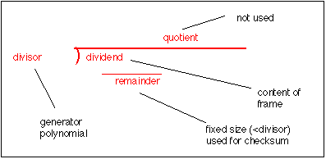
Sender side
Receiver side

Slide 8
Receiver side : Assume that,
there is a single error. The syndrome is not all 0s (it is 011)

Slide 10
Standard Polynomials

Slide 11
Advantages of Cyclic Codes
good performance in detecting single-bit errors, double errors, an odd number of errors, and burst errors.

Slide 12
CHECKSUM
Checksum is an error-detecting technique that can be applied to a message of any length.
In the Internet, the checksum technique is used at the network and transport layer rather than the data-link layer

Slide 14
Error Detection by Checksums
For error detection by checksums, data is divided into fixed sized frames or segments.
Sender’s End − The sender adds the segments using 1’s complement arithmetic to get the sum. It then complements the sum to get the checksum and sends it along with the data frames.
Receiver’s End − The receiver adds the incoming segments along with the checksum using 1’s complement arithmetic to get the sum and then complements it.
If the result is zero, the received frames are accepted; otherwise they are discarded.

Slide 15
Concept
Example :
Suppose the message is a list of five 4-bit numbers that we want to send to a destination.
set of numbers is (7, 11, 12, 0, 6), we send (7, 11, 12, 0, 6, 36),
where 36 is the sum of the original numbers.
The receiver adds the five numbers and compares the result with the sum.
If the two are the same, the receiver assumes no error, accepts the five numbers, and discards the sum.
Otherwise, there is an error somewhere and the message is not accepted.

Slide 17
Step 1: 0111 1011 ------- 1)0010 1 ------- 0011 ----------
Sender Side
Step 2: 0011 1100 ------- 1111 -------
Step 3: 1111 0000 ------- 1111 -------
Step 4: 1111 0110 ------- 1)0101 1 ------- 0110
----------
7 binary form : 111
11 binary form : 1011
12 binary form : 1100
0 binary form : 0000
6 binary form : 110
------------------------------
Step 5 :
Take 1’s complement : 1001
Check sum is :1001
Decimal value is :9
Sender Side : Data : 0111 1011 1100 0000 0110 Checksum 1001

Slide 18
Step 1: 0111 1011 ------- 1)0010 1 ------- 0011 ----------
Receiver Side
Step 3: 1111 0000 ------- 1111 -------
Step 5: 0110 1001 →checksum ------- 1111 → take complement
---------
Result is : 0000
If all the bits in result is 0, then, accept the data.
Else, discard the data because there is an error.
Step 2: 0011 1100 ------- 1111 -------
Step 4: 1111 0110 ------- 1)0101 1 ------- 0110
----------

Slide 19
Problem
Suppose that a message 1001 1100 1010 0011 is transmitted using Internet Checksum (4-bit word). What is the value of the checksum?

Slide 20
Problem
Suppose that the sender wants to send 4 frames each of 8 bits, where the frames are 11001100, 10101010, 11110000 and 11000011.

Slide 21
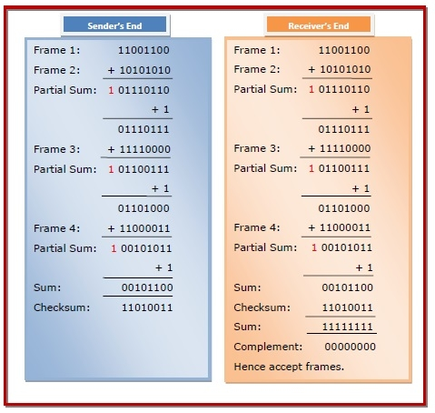
Example
Suppose that the sender wants to send 4 frames each of 8 bits, where the frames are 11001100, 10101010, 11110000 and 11000011.

Slide 22
Problem
Suppose the data we want to send consists of the following three words:
0110011001100000
0101010101010101
1000111100001100

Slide 23
The check sum of 10010010 and 00111000 (8 bit segment) is ___________ :
(1) 00110110
(2) 11001010
(3) 00110101
(4) None of these

Slide 24
If the data unit to be transmitted is 10101001 00111001, the following procedure is used at Sender site and Receiver site.

Slide 25
The message 11001001 is to be transmitted using the CRC polynomial x^3 + 1 to protect it from errors. The message that should be transmitted is:
(A) 11001001000
(B) 11001001011
(C) 11001010
(D) 110010010011

Slide 26
https://www.mathsisfun.com/algebra/polynomials-division-long.html

